Slide 1
MOBILE NETWORK ACCESS DEVICE FOR USE WITH THE DHS ADVANCED CONTAINER SECURITY SYSTEM
Sergio Enriquez

Slide 2
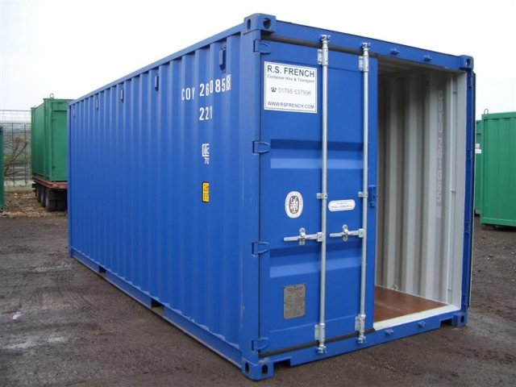
The cargo security problem
Cargo containers subject to theft, tampering, used to smuggle contraband.
Need for more comprehensive and automated monitoring.
Need for open standards to integrate excising and future security devices as part of centrally controlled program

Slide 3
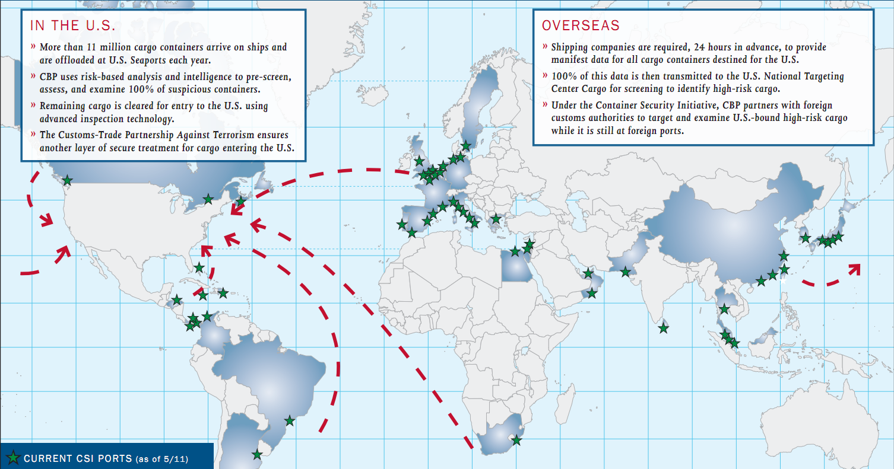
Cargo Security Initiative
Established in 2002 to work towards improving security of US ports and cargo

Slide 4
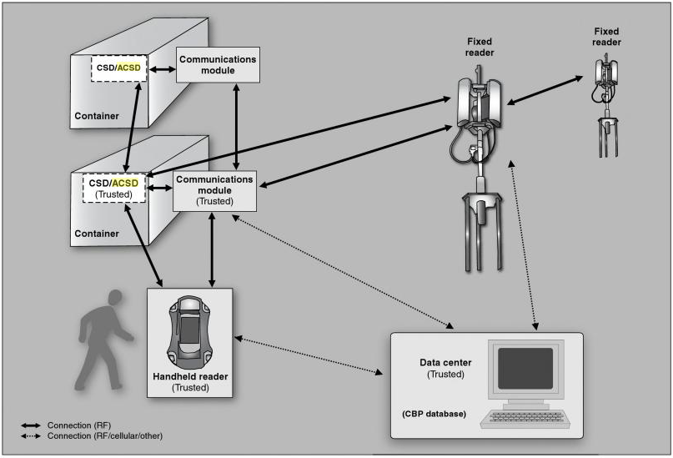
Cargo Security Test Program
Electronic Security devices are mounted on containers
NAD units maintain continuous monitoring of status and relay data to central server
Open standard defined to allow use of commercially made products

Slide 5
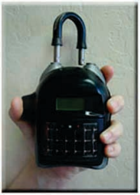
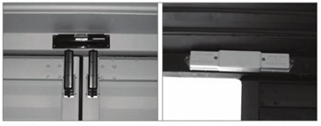
Sample Components
External Mounting
Electronic Chain of Custody Device (ECOC)
Internal Mounting:
Container Security Device (CSD)
(MATT)
(HCSD)

Slide 6
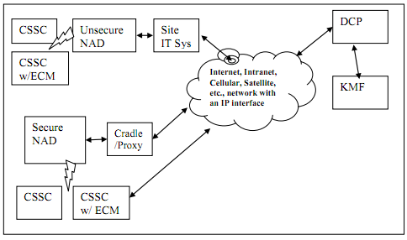
System Components
CSSC attached to containers
CSSCs communicate with NADs
Security status monitored by DCP
KMF stores CSSC encryption keys

Slide 7
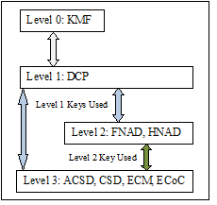
ICD Security Overview
KMF stores system component encryption keys
KMF only communicates with DCP
AES encryption used to generate new keys and decrypt messages
DCP sends re-key messages to lvl2 or lvl3 devices

Slide 8
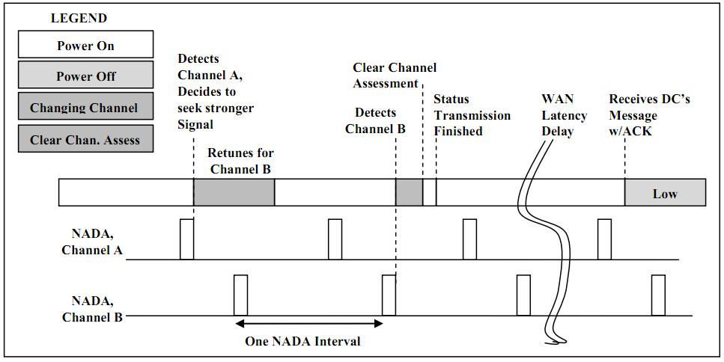
Network Detection
NADs announce presence through network broadcasts
CSDs listen for broadcast and associate with the source having best signal strength

Slide 9
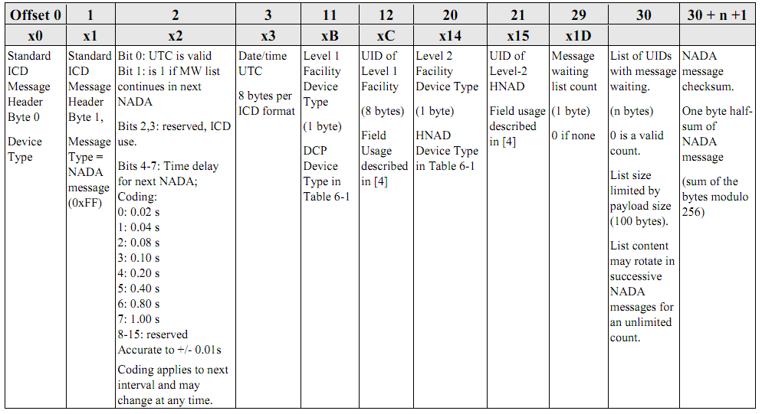
NADA Message

Slide 10
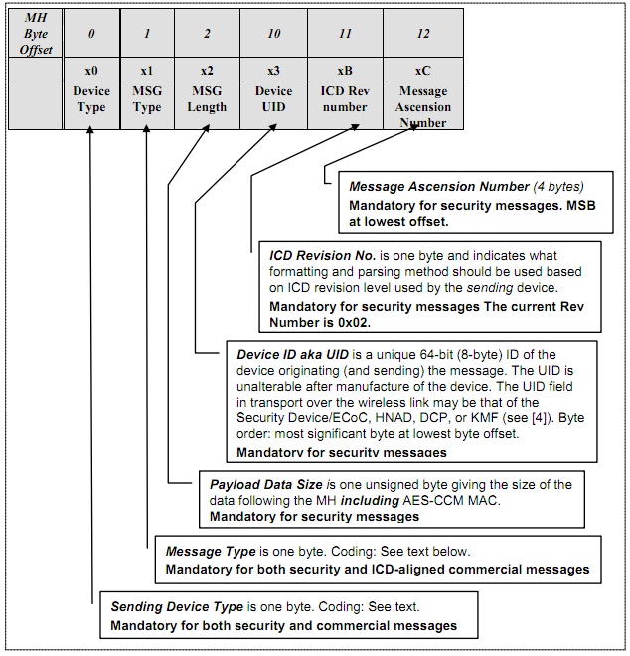
ICD Packet Header
Header identifies message source, type, and payload information

Slide 11
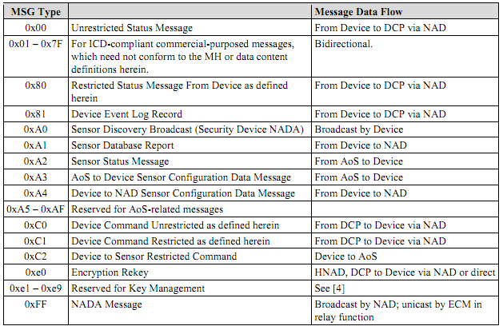
ICD Message Types
1 bye field identifies ICD message types
Other values available for commercial messages

Slide 12
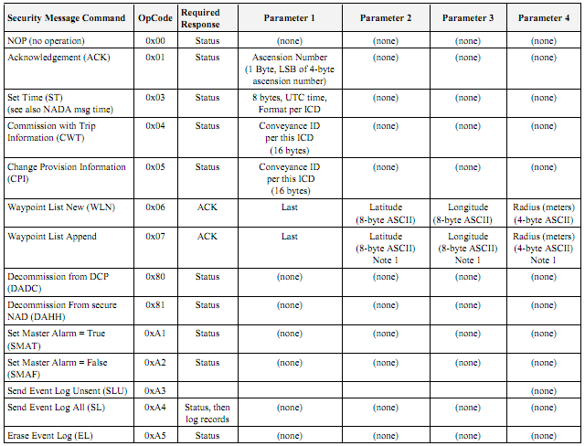
ICD Restricted Commands
Sent by CSD of secure NAD to control CSD operation or query data

Slide 13
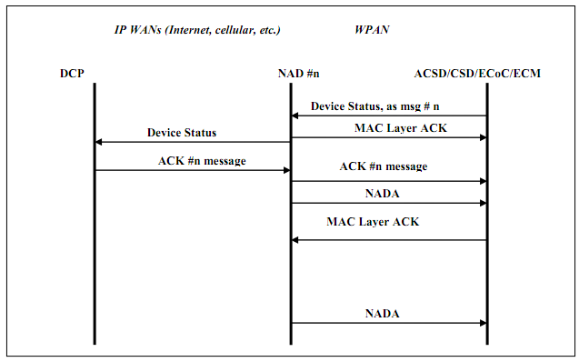
Unrequested Status Message
Not requested by NAD or DCP
Send by CSD periodically
Recipient is DCP

Slide 14
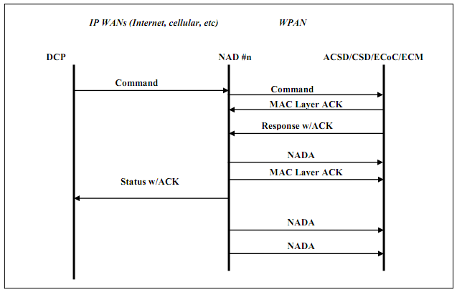
Command Message
Sent by DCP or secure NAD
ACK reply in form of status message

Slide 15
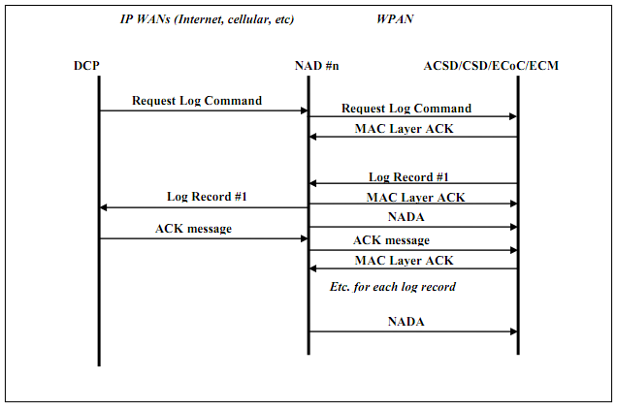
Log Message
Sent in response to query logs command
One ACK per record

Slide 16
ICD Network Communication
Protocol defines DCP to NAD communications
Used to forward ICD messages, change network configuration, monitor NAD status

Slide 17
ICD Packet Preamble
TCP packets use standard preamble
Function code field identifies message type
Field | Size (bytes) | Purpose
Revision | 1 | ICD revision used by source
Function Code | 1 | Identifies the payload type of this message
UID | 8 | Unique ID of the device transmitting this message
Payload | Varies | Content of this message
Code | Type
0 | Heartbeat
1 | Heartbeat Request
2 | ICD Content, DCP to NAD
3 | ICD Content, NAD to DCP
4 | DCP Configuration Change

Slide 18
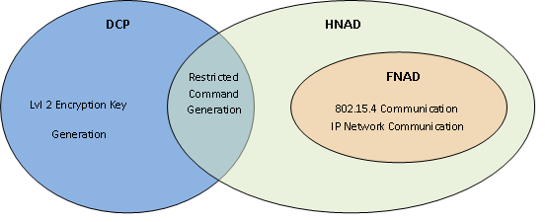
HNAD Unit
Can generate commands like DCP
Communicates with DCP directly
Stores temporary access keys

Slide 19
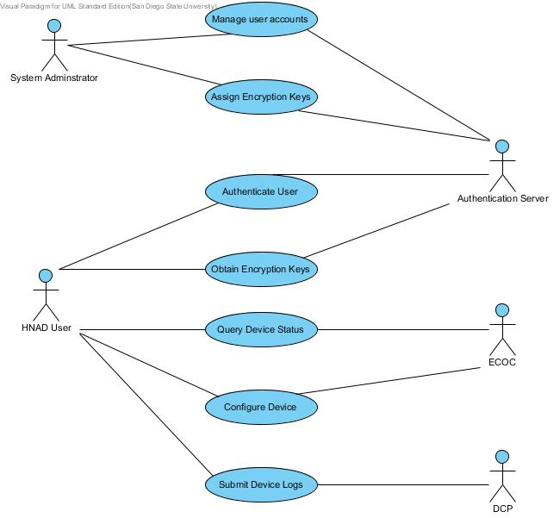
HNAD Use Cases
HNAD user can:
Query CSD status
Request CSD logs
Configure CSD
Clear CSD alarms
Upload HNAD and CSD logs to DCP

Slide 20
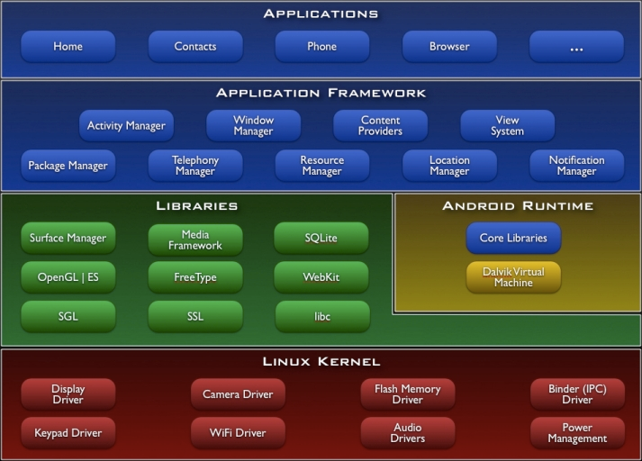
Android OS
OS for handheld devices based on Linux kernel
Programs use Android API and are compiled to byte code
Programs run on the Dalvik virtual machine

Slide 21
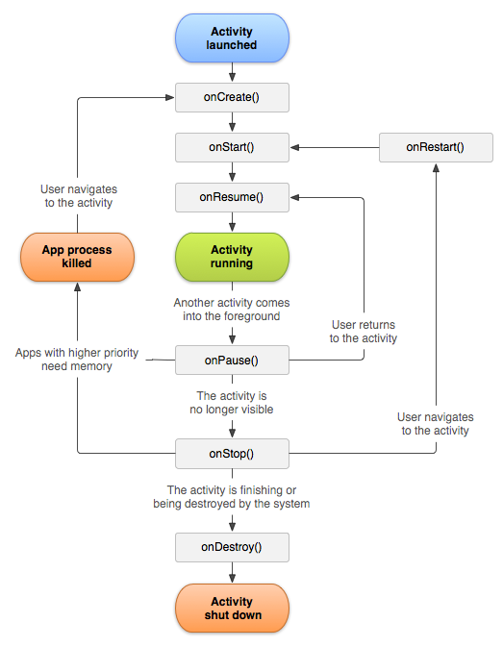
Android Activities
Activities are associated with a particular user screen
OS can suspend and resume activities as required by user interaction

Slide 22
Android Services
Services run in the background and can be interacted with by activities
Communication can be done through object references or system broadcasts
Will continue to run until explicitly ended by an activity
Uses same thread as the UI activity process, unsuitable for executing long running tasks

Slide 23
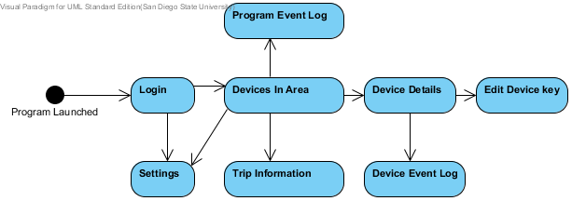
HNAD Activities
HNAD operation is broken into 8 user screens
Program launched by user or the connection of USB bridge

Slide 24
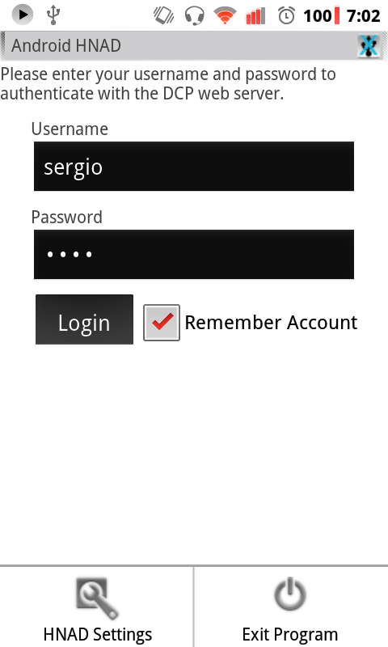
Login Activity
Used to login to the authentication server
User needs to only login once to the device if configured to remember credentials

Slide 25
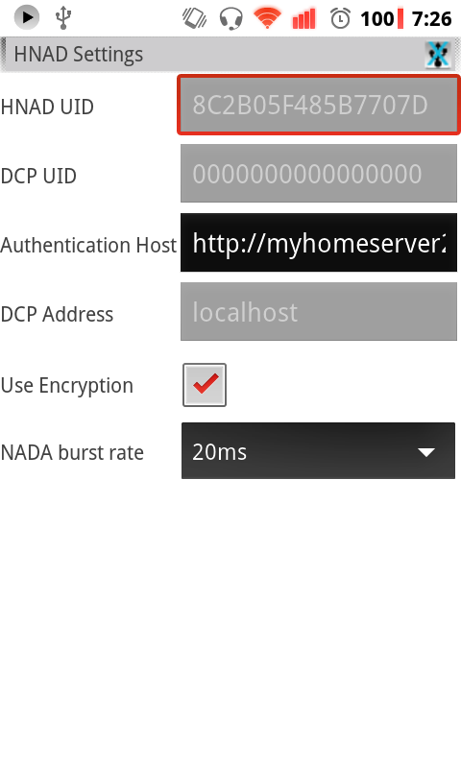
Configuration Activity
Used to configure authentication server address and various other operation settings

Slide 26
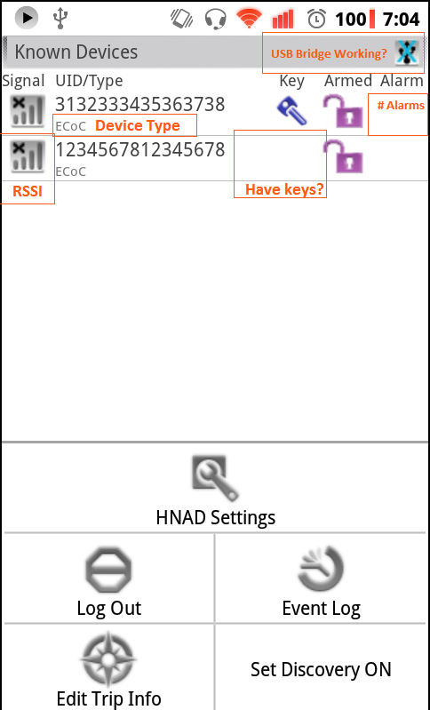
Devices in Area Activity
Displays CSD devices in radio range or if HNAD possesses keys
Quick status display of device

Slide 27
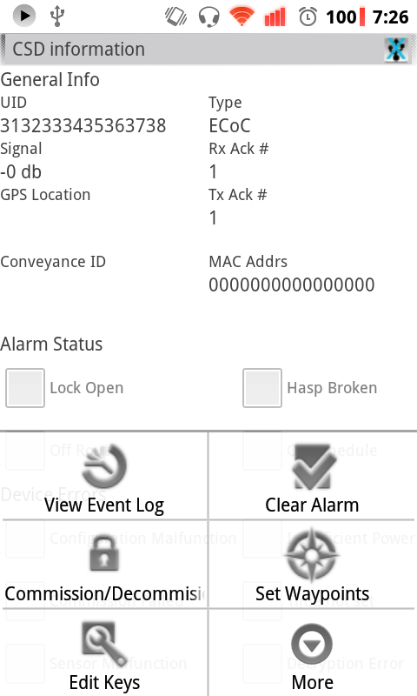
Device Details Activity
Displays all device information
Data obtained from secured status query

Slide 28
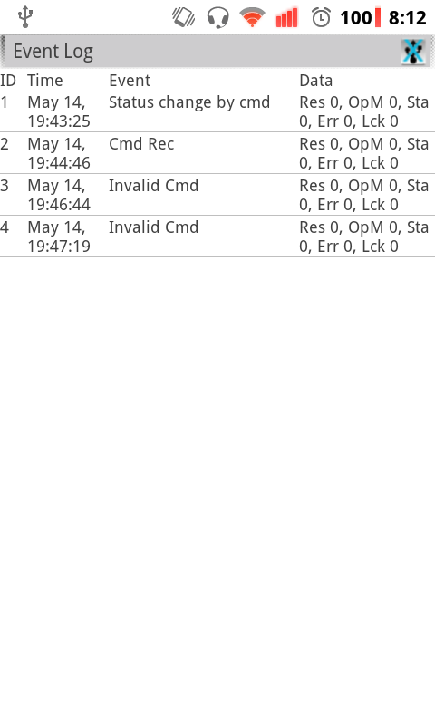
Device Log Activity
Displays event log data collected from CSDs
Obtained from secured retrieve logs query

Slide 29
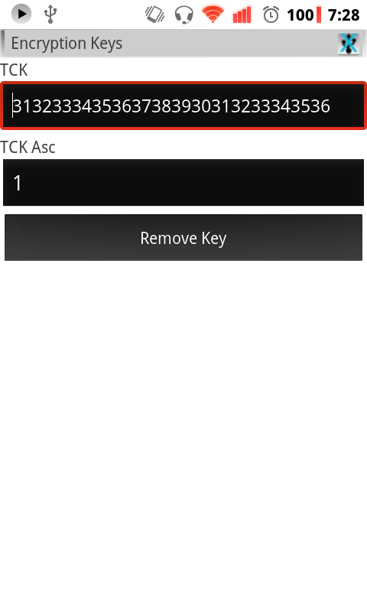
Device Key Edit Activity
Used to change the temporary encryption keys used by a device

Slide 30
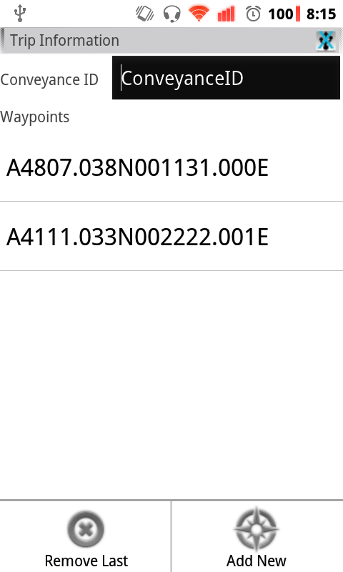
Trip Edit Activity
Used to set the conveyance ID and trip waypoint list

Slide 31
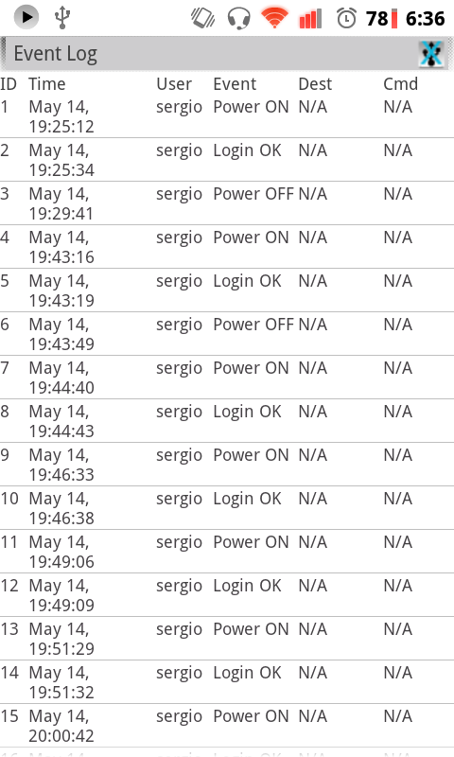
HNAD Log Activity
Displays stored event log for the HNAD unit

Slide 32
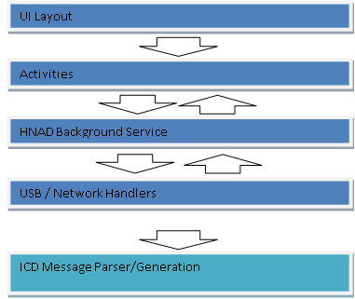
HNAD Application Organization
Application structured to make it easier to extend functionality in future

Slide 33
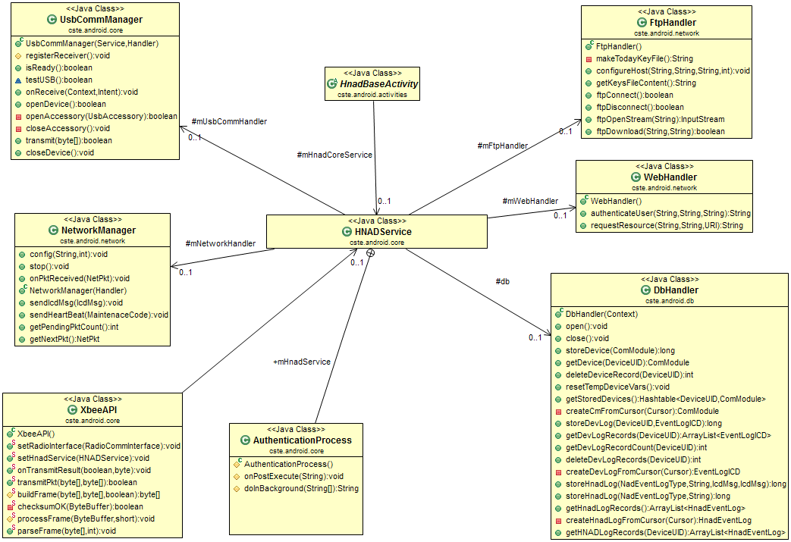
HNAD Service Components

Slide 34
HNAD Service Commands
Broadcast type | Purpose | Payload
DEVICE_INFO_CHANGED | The status or some member variable of a device has changed due to the arrival of an external message | UID of affected device
DEVLIST_CHANGED | A new device is visible, or its record has been deleted from memory. | UID of new/removed device
LOGIN_RESULT | Result of an authentication attempt | Boolean
UPLOAD_DATA | Result of submitting data to the DCP over the internet | Boolean
USB_STATE_CHANGED | USB accessory has been disconnected/ connected | Boolean
TRANSMISSION_RESULT | Result of sending data to a device on the 802.15.4 wireless network | UID of destination, Boolean
ECM_EVENTLOG_CHANGE | A new device record was added | UID of affected device, Row ID
HNAD_EVENTLOG_CHANGE | A new HNAD record was added | Row ID

Slide 35
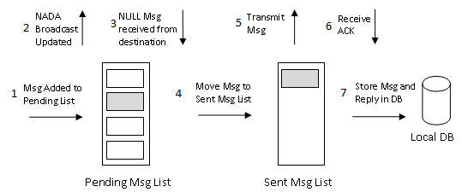
ICD Message Transmission
HNAD maintains two message lists to handle the ICD message waiting requirements
All transactions recorded to HNAD local database

Slide 36
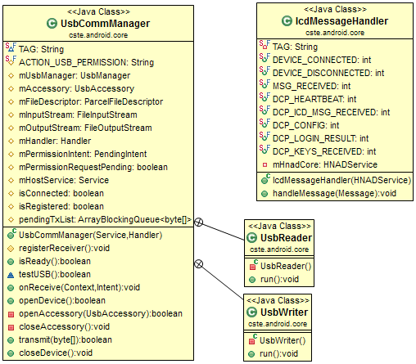
USB Process
Handles communications with external USB to XBEE bridge device

Slide 37
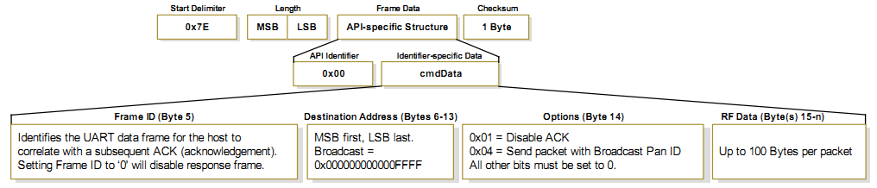
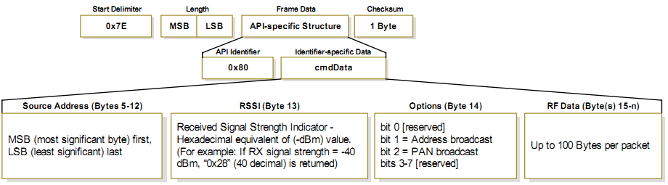
XBEE API
Generates and parses XBEE compatible frame messages

Slide 38
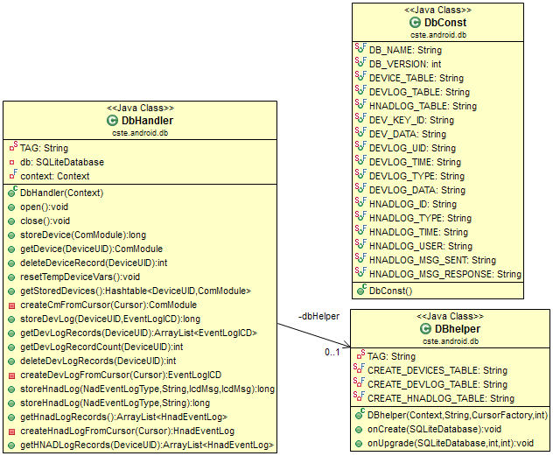
Database Handler
Stores:
HNAD logs
CSD logs,
CSD device information
Implemented using SQLite local database

Slide 39
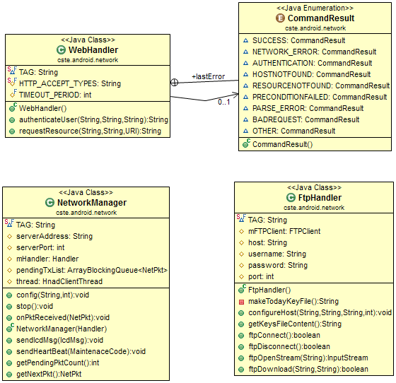
Network Communication
Handles communication over IP network
Components:
FTP handler
HTTP Handler
TCP packet handler

Slide 40
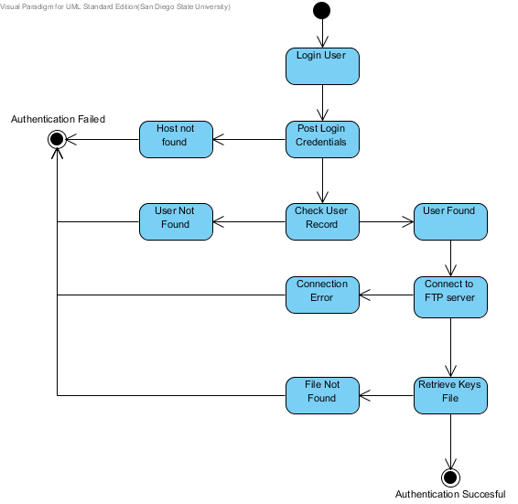
Authentication Process
Sends user login credentials to authentication server and processes received reply

Slide 41
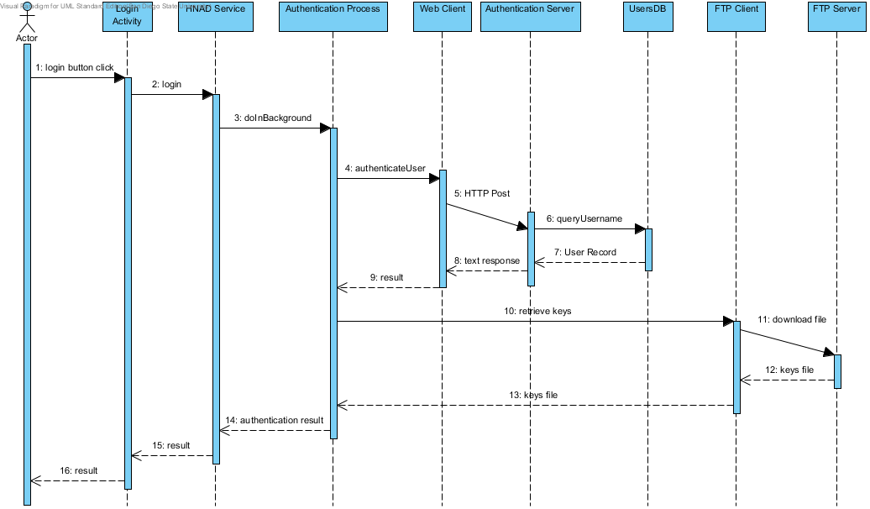
Authentication Process

Slide 42
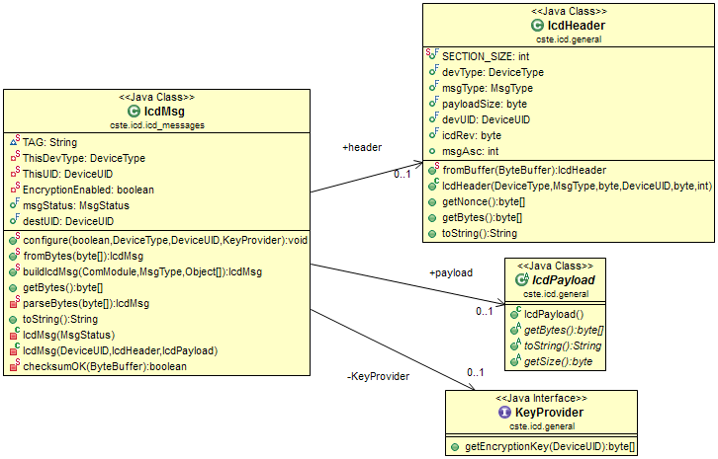
ICD Message Processing
Generates and parses TCP packet communications with DCP server

Slide 43
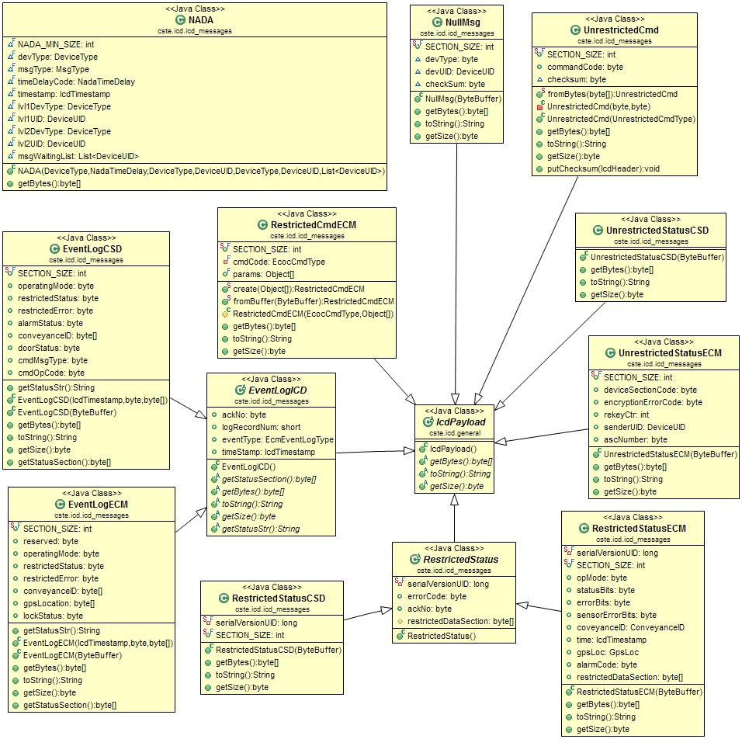
ICD Packet Payloads
Defines ICP packets sent over WPAN
ICD messages organized into different payload classes
Different devices have their own payload format and content

Slide 44
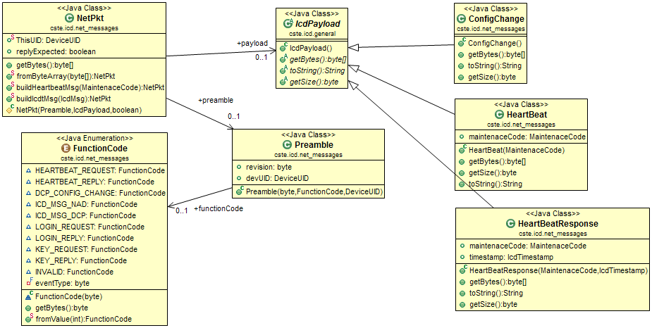
ICD IP Messages
Defines packet format for ICD IP packets

Slide 45
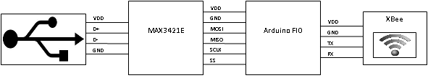
USB to XBEE Bridge
Used to relay communications from HNAD unit to 802.15.4 WPAN network
Implemented using off the shelf XBEE radio module and Arduino board

Slide 46
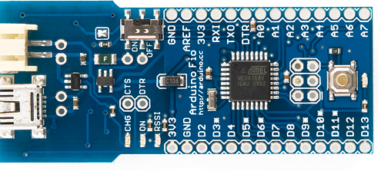
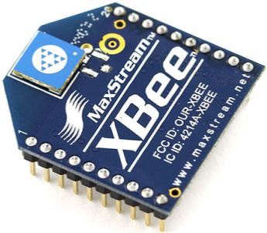
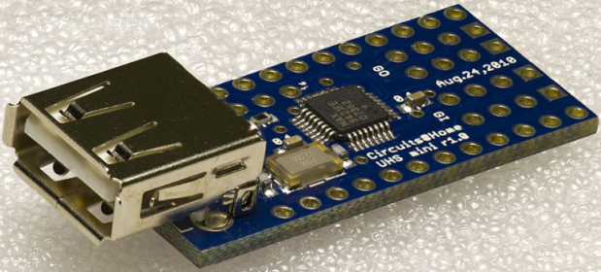
Bridge Components
Arduino board transfers data from XBEE module to USB controller
USB controller uses Android ADK to communicate with Android devices

Slide 47



Authentication Web Server
Implemented using Tomcat server
Server hosts servlets to process user login and CSD encryption key management
Server data stored into MySQL database
HNAD downloads keys from FTP server

Slide 48
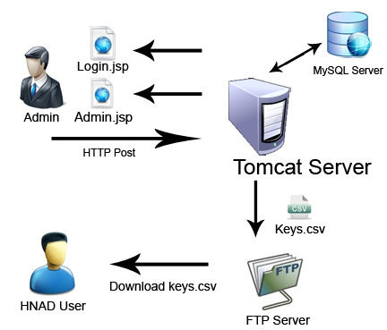
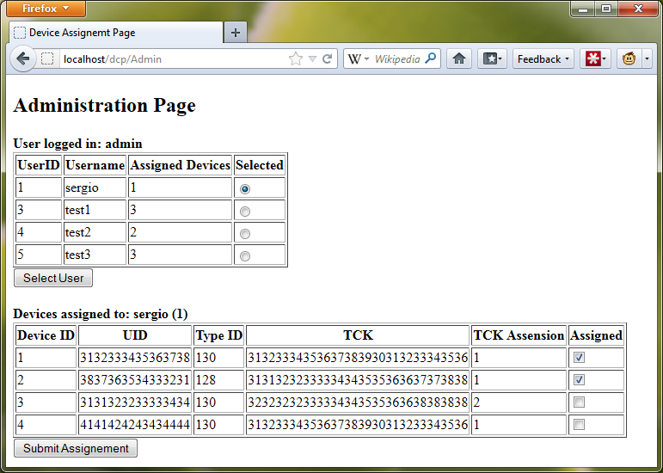
Authentication Server Operation
System admin assigns CSD keys to HNAD user
Server generates and stores keys file into FTP server
HNAD logs into authentication server and receives temporary credentials to download keys from FTP server

Slide 49

Questions

